Slide 1
Layback Garments
Website & Mobile App Prototype Presentation
Presented by: LayBack Devs
Team Members:
-Lwandle Msiya (Project Manager) – ST10406108
-Itumeleng Kola (Business Analyst) – ST10075573
-Tumelo Teka (Software Developer) –ST10126814

Slide 2
Presentation Overview
1. Opening Remarks
2. Project Introduction
3. Website Prototype Demo
4. Mobile App Prototype Demo
5. Challenges & Solutions
6. Conclusion & Future Improvements
7. Q&A Session
8. DevOps Update
9. Closing Remarks

Slide 3
Project Introduction
Group Name: LayBack Devs
Group Members:
-Lwandle Msiya (Project Manager)
-Itumeleng Kola (Business Analyst)
-Tumelo Teka (Software Developer)
Project Title: Layback Garments Online Experience
Problem Statement: Local apparel brands often lack an integrated, engaging digital platform to represent their style and connect with customers.
Objective: To design a responsive website and mobile app that enhances brand identity, streamlines shopping, and builds community.

Slide 4
Website Prototype Demo
Design Tools Used: [Visual Studio Code].
UI/UX.
Screenshots of the website prototype.

Slide 5
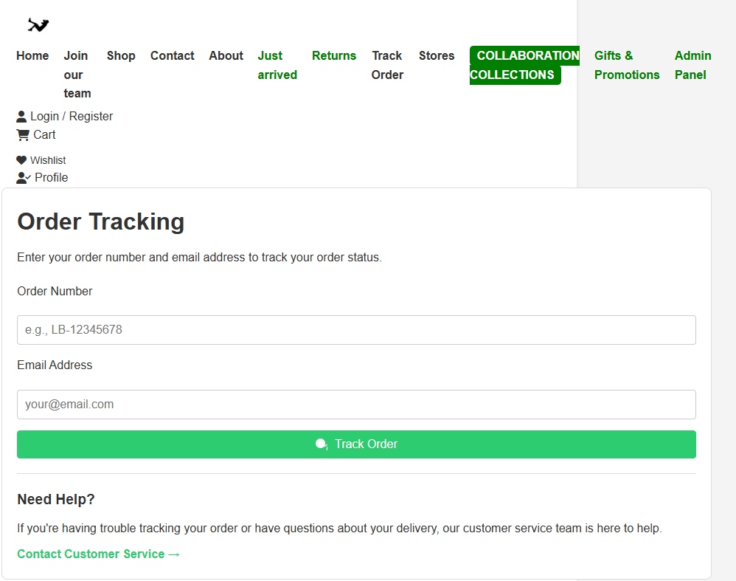

Slide 6
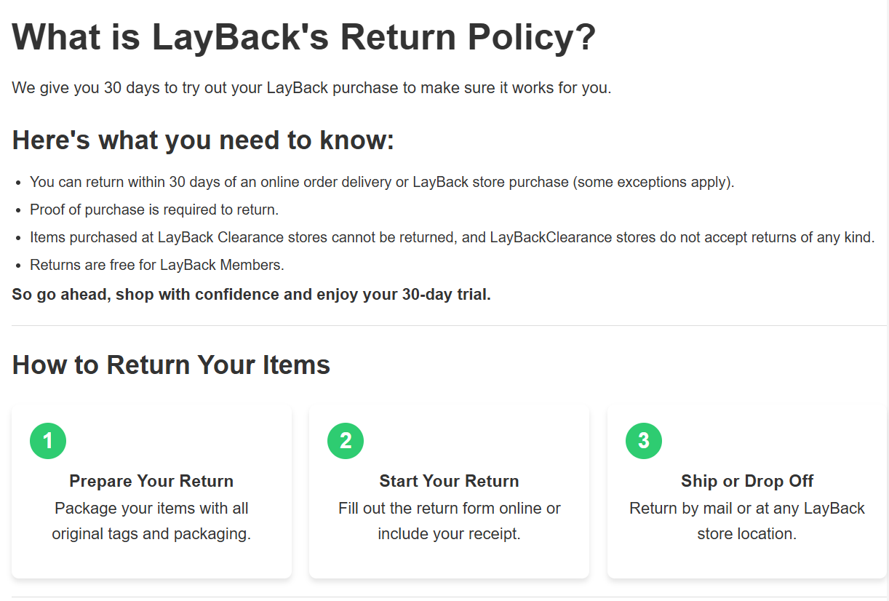

Slide 7
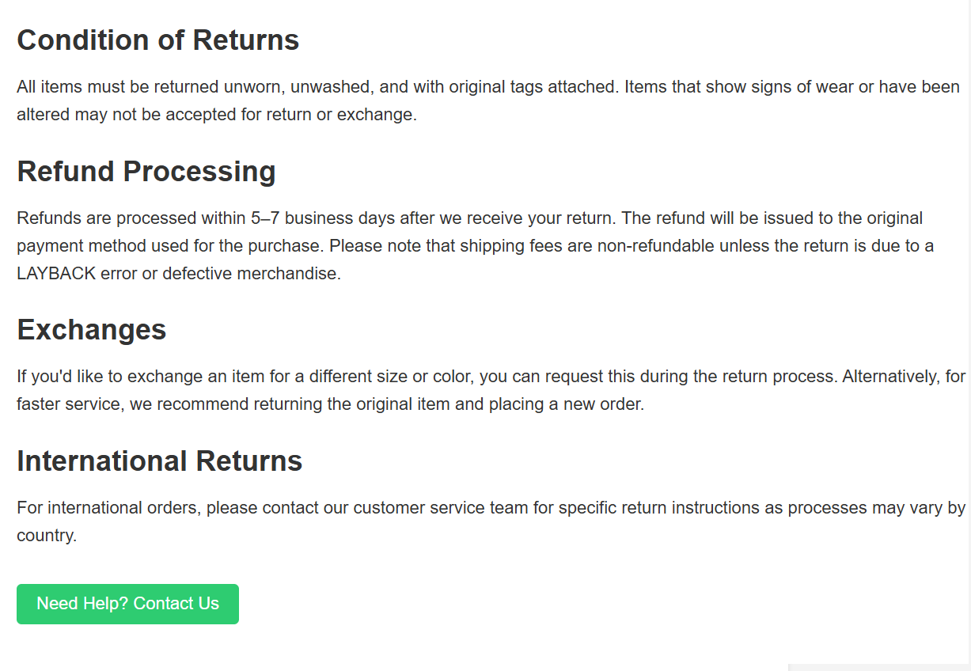

Slide 8
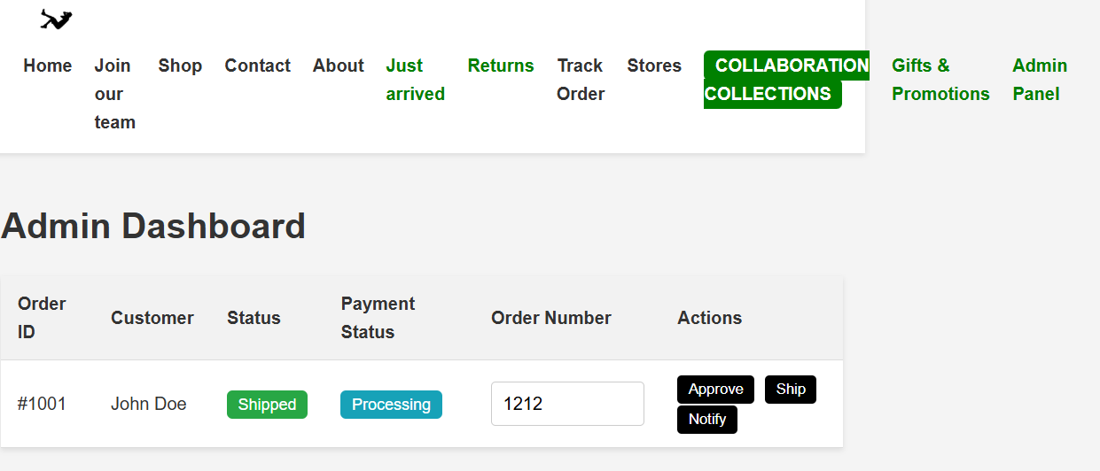

Slide 9
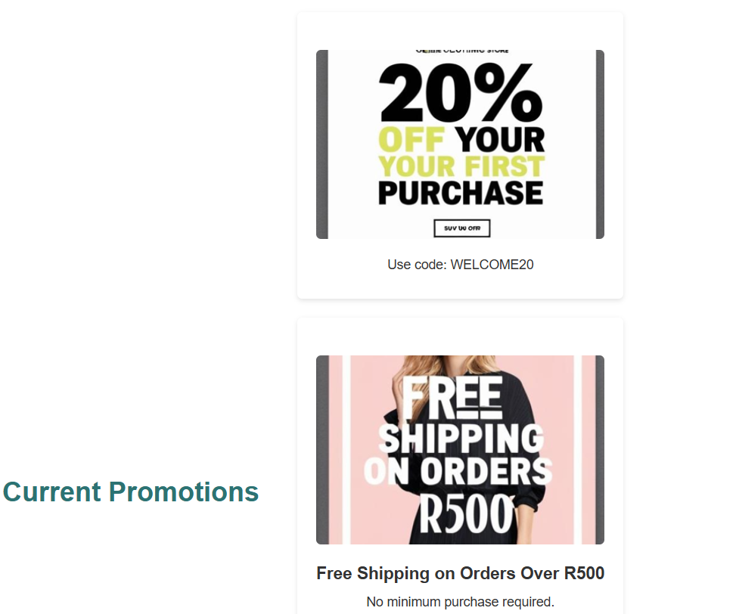

Slide 10
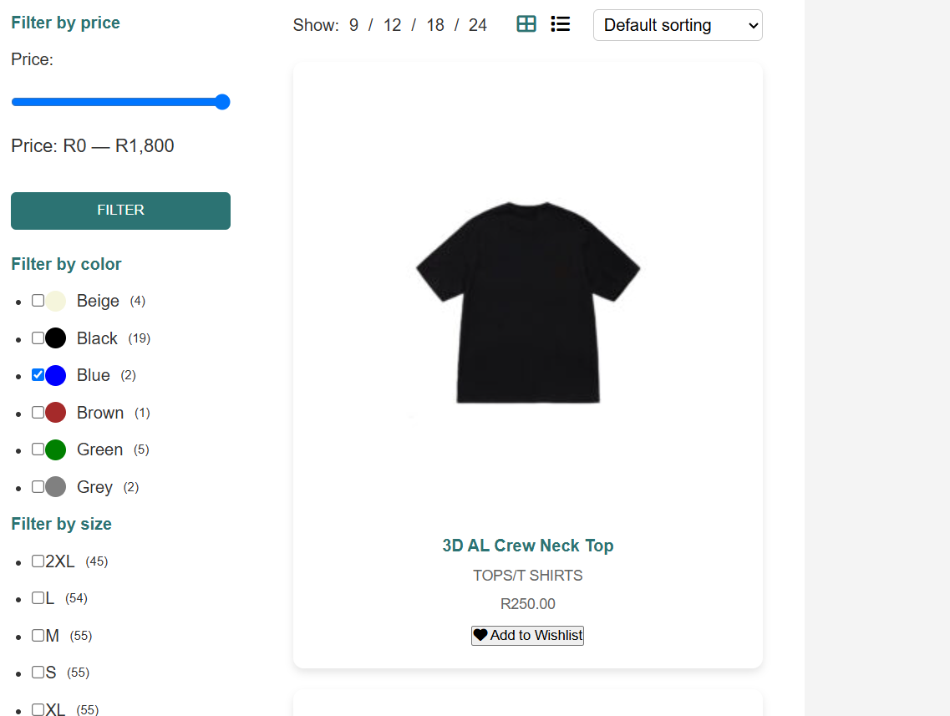

Slide 11
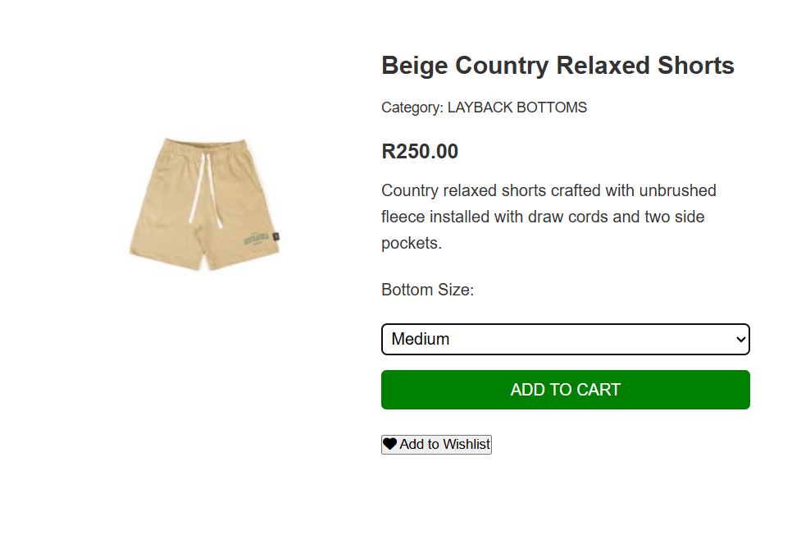

Slide 12
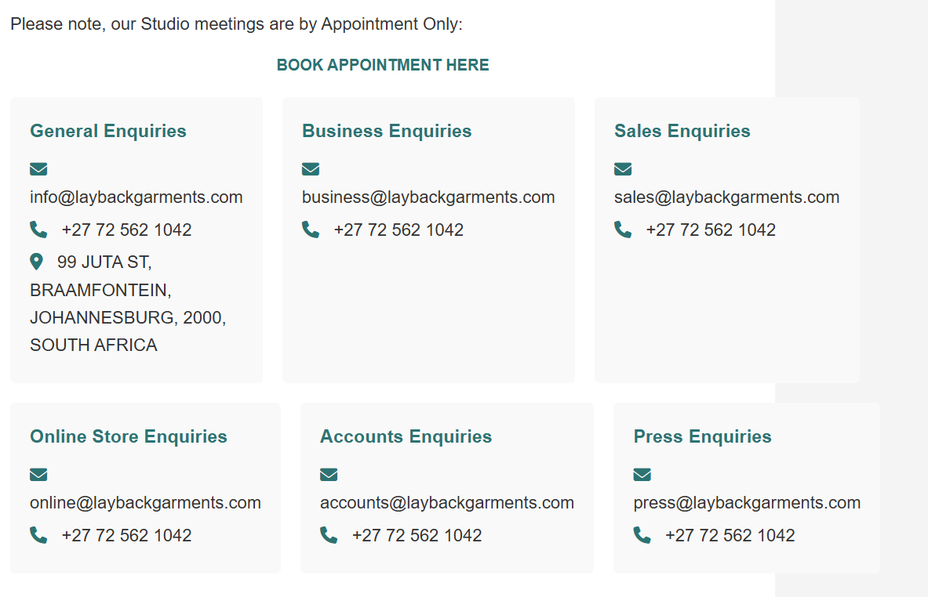

Slide 13
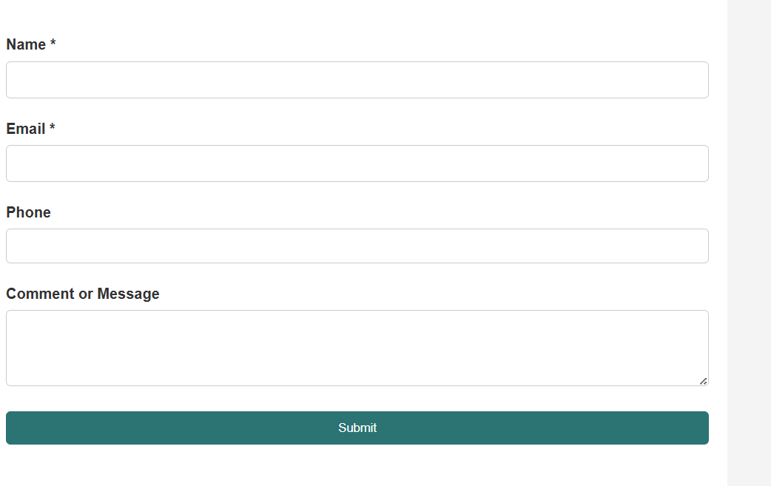

Slide 14
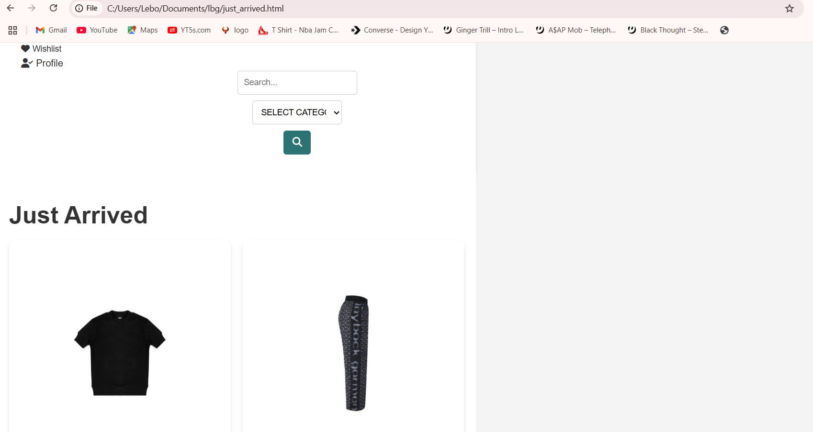

Slide 15
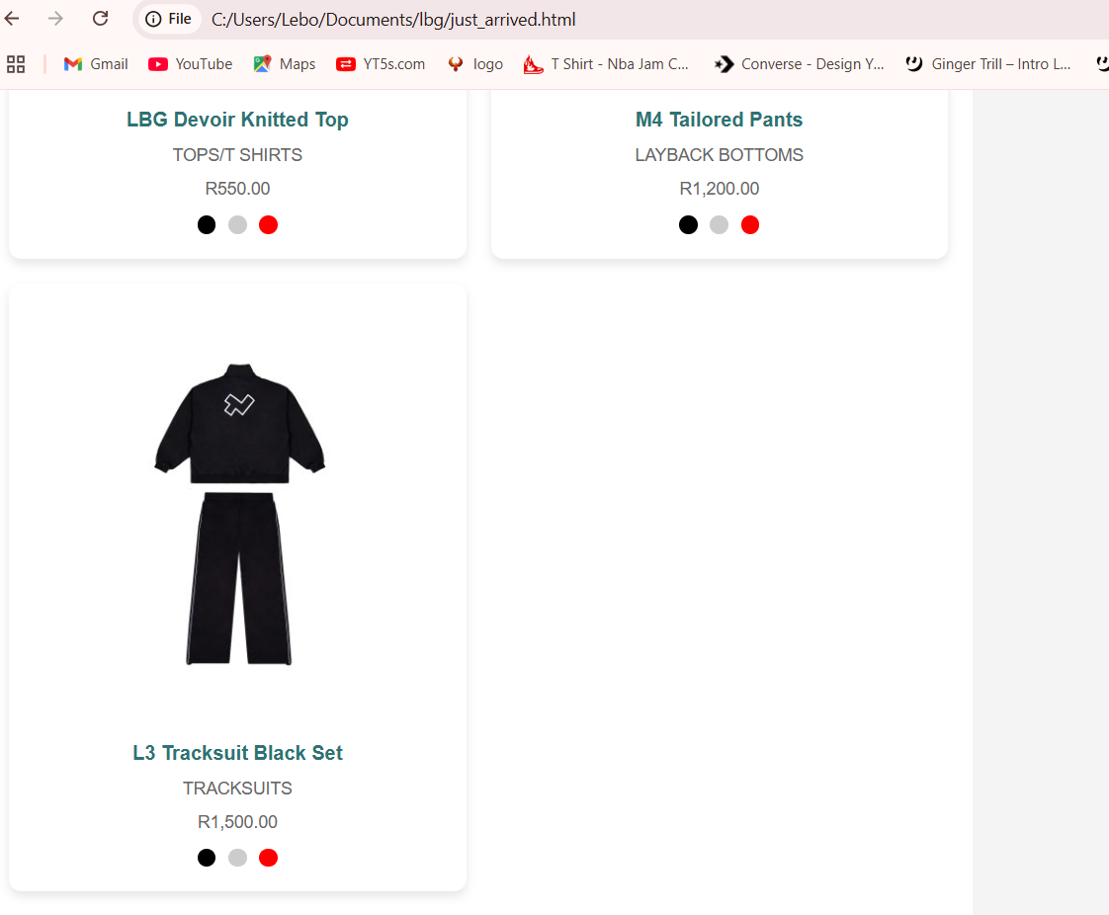

Slide 16
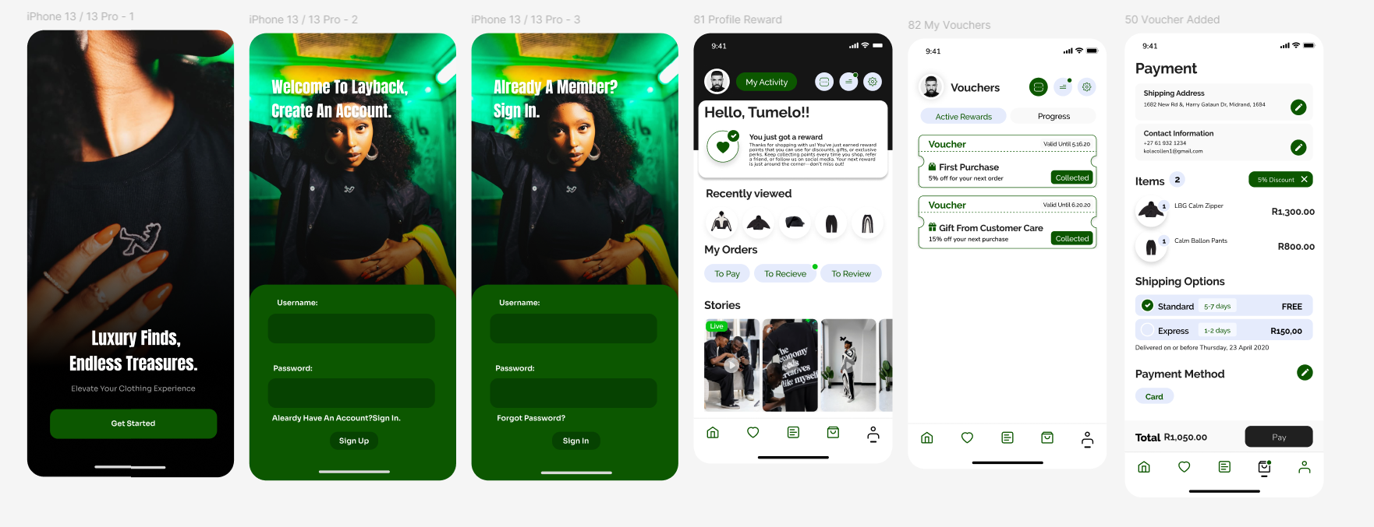
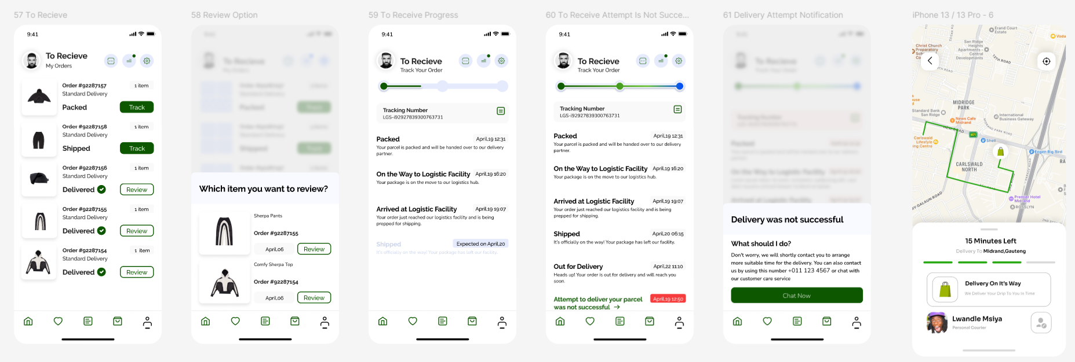
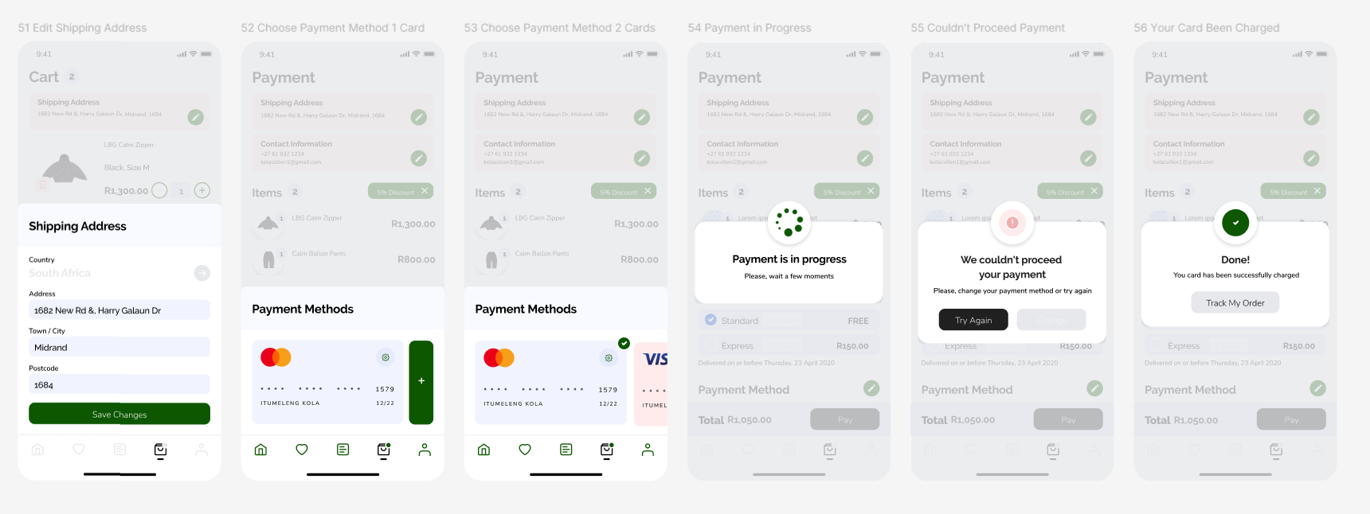
Mobile App Prototype Demo
Navigation Overview:

Slide 17
Challenges
Challenges Faced:
Changing requirements mid-project (e.g., Policy Page, Order Tracking, Coupons)
Inconsistent UX/UI due to multiple contributors
Complex coupon code validation logic
Reworking database schema for new features
Inconsistent display on mobile and tablet devices
Limited team size causing workload distribution issues
Reassessed

Slide 18
Solutions
Solutions Implemented:
scope, updated requirements, reallocated tasks, extended schedule
Introduced standardized UI kit and enforced design templates
Implemented server-side validation and flexible discount schema
Revised ERD, redefined relationships, and managed data migration via SQL
Refactored CSS, added responsive testing, used BrowserStack
Redistributed tasks weekly, prioritized features, brought in a part-time tester

Slide 19
Conclusion
This project successfully delivered a efficient e-commerce platform for a digital clothing brand.
The system enables user registration, product browsing, secure order placement, coupon application, policy display, and order tracking.
Despite challenges such as changing requirements and tight resources, the team demonstrated adaptability and coordination, leading to the completion of a functional and user-friendly system.
The inclusion of essential backend operations such as product management, return handling, and administrative control further ensures that the platform can be maintained and scaled by non-technical users in the future.

Slide 20
Future Improvements
Future Improvements
• Mobile App Integration: Develop a native app to enhance mobile experience and increase customer retention.
• AI-Based Product Recommendations: Integrate a recommendation engine to suggest items based on user behaviour and preferences.
• Live Chat Support: Add real-time customer support functionality to improve user engagement and trust.
• Inventory Automation: Automate stock tracking and notifications to reduce manual effort and improve inventory accuracy.
• Customer Reviews System: Allow users to rate and review products for social proof and increased conversions.
• Analytics Dashboard Enhancements: Provide more detailed metrics like customer retention, popular products, and coupon performance.
• Multi-language & Currency Support: Expand for global reach with localization features.

Slide 21
Q&A Session
We’re ready for your questions!
- Feedback welcome
- Suggestions appreciated

Slide 22
DevOps Update
Version Control:
- GitHub used for source control
- Branching & pull request model
Deployment Pipeline:
- Currently in staging phase using [Vercel/Netlify/etc.]
- Future CI/CD steps to include auto-deploy on merge
Next Steps:
- Automate tests
- Set up monitoring and logs

Slide 23
Closing Remarks
Thank you for your attention and feedback!
We appreciate the guidance throughout this project.
Final submission deadline: 02/06/2025
Team Layback Garments signing out!

